Slide 1
Group - 11
About Us
01
02
03
AU2040014 Jay Patel
AU2040021 Dhanya Mehta
AU2040265 Spandan Shah

Slide 2

Small Object Detection
Using Baseline deep learning models like, QueryDet, EfficientDet, SyNet, End to End DEtection Transformer, HoughNet and YOLOV5.
Guide:
Prof. Mehul Raval
CSE541 + CSE523
Year 2023

Slide 3
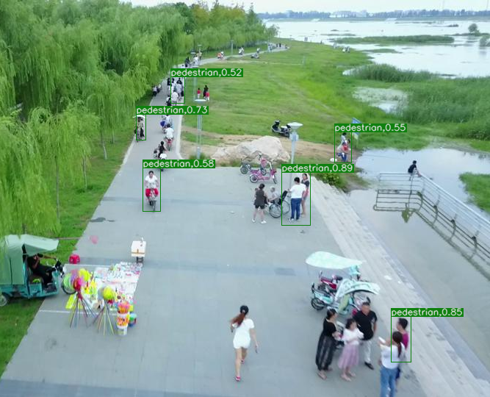
Introduction
Small Object Detection
Evaluate performance of various object detection techniques (in case of small objects) on VisDrone dataset.

Slide 4
Dataset
Visdrone 2019
Class | No of boxes
Pedestrian | 79337
Car | 144865
Tricycle | 4812
Motor | 29647
People | 27059
Class | No of boxes
Van | 24956
Awning-tricycle | 3246
Bicycle | 10480
People | 12875
Bus | 5926
Total no of Boxes: 343203

Slide 5
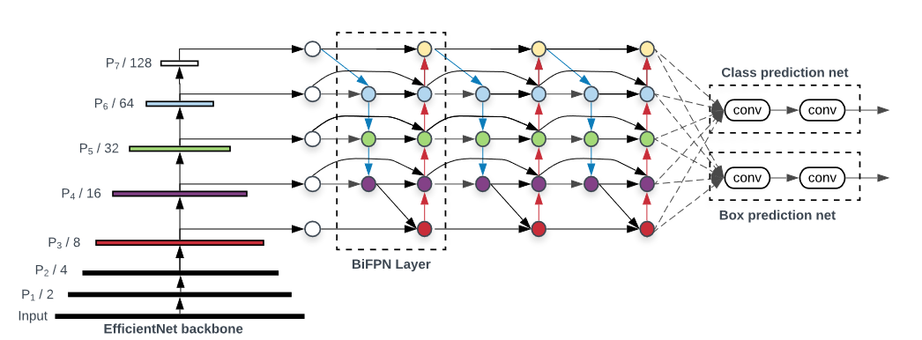
Model Architectures
EfficientDet
[1]
[1]Tan, M., Pang, R., & Le, Q. V. (2020, July 27). EfficientDet: Scalable and efficient object detection. arXiv.org. Retrieved March 2, 2023, from https://doi.org/10.48550/arXiv.1911.09070

Slide 6
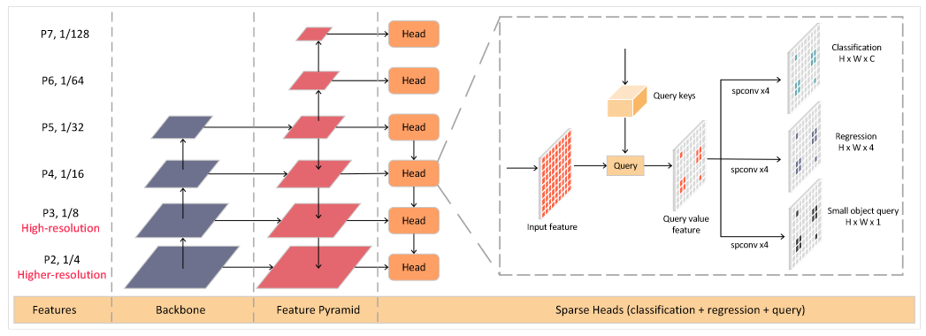
QueryDet
[2]
[2]Yang, C., Huang, Z., & Wang, N. (2022, March 24). Querydet: Cascaded sparse query for accelerating high-resolution small object detection. arXiv.org. Retrieved March 1, 2023, from https://arxiv.org/abs/2103.09136

Slide 7
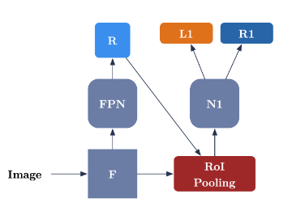
Faster RCNN
[3]
[3]Albaba, B. M., & Ozer, S. (2020, December 23). SyNet: An ensemble network for object detection in UAV images. arXiv.org. Retrieved March 24, 2023, from https://doi.org/10.48550/arXiv.2012.12991

Slide 8
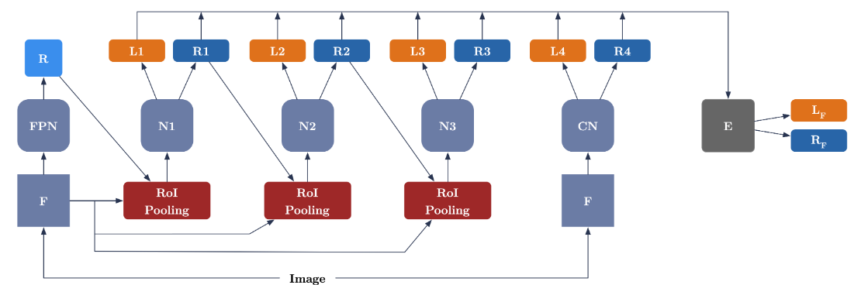
SyNet
[3]
[3]Albaba, B. M., & Ozer, S. (2020, December 23). SyNet: An ensemble network for object detection in UAV images. arXiv.org. Retrieved March 24, 2023, from https://doi.org/10.48550/arXiv.2012.12991

Slide 9
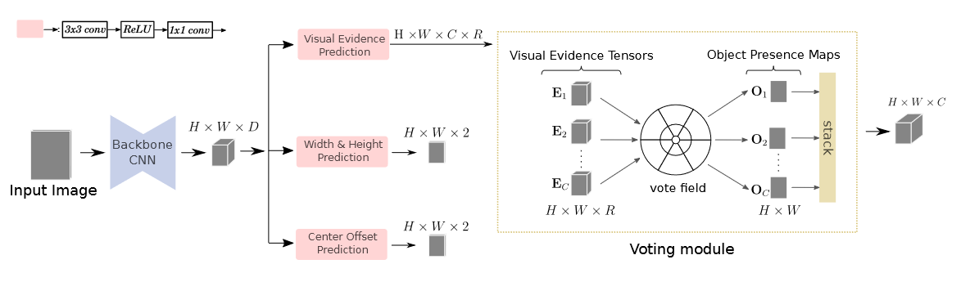
HoughNet
[4]
[4]Samet, N., Hicsonmez, S., & Akbas, E. (2020, July 24). Houghnet: Integrating near and long-range evidence for bottom-up object detection. arXiv.org. Retrieved April 2, 2023, from https://doi.org/10.48550/arXiv.2007.02355

Slide 10
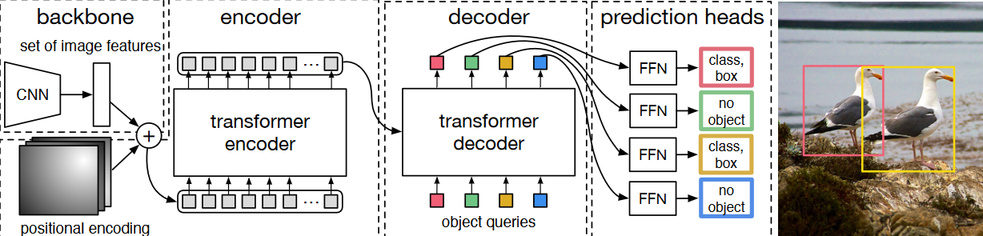
End to End Detection
[5]
[5]Carion, N., Massa, F., Synnaeve, G., Usunier, N., Kirillov, A., & Zagoruyko, S. (2020, May 28). End-to-end object detection with Transformers. arXiv.org. Retrieved March 27, 2023, from https://doi.org/10.48550/arXiv.2005.12872

Slide 11
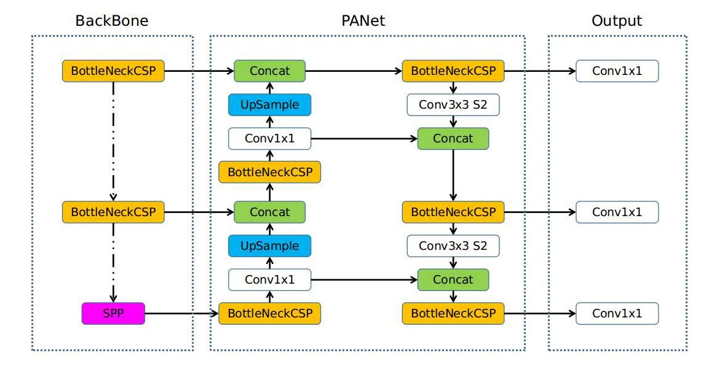
YOLO V5
[6]
[6]jocher, glenn. (n.d.). Ultralytics/yolov5: Yolov5 🚀 in PyTorch > ONNX > CoreML > TFLite. GitHub. Retrieved April 10, 2023, from https://github.com/ultralytics/yolov5

Slide 12
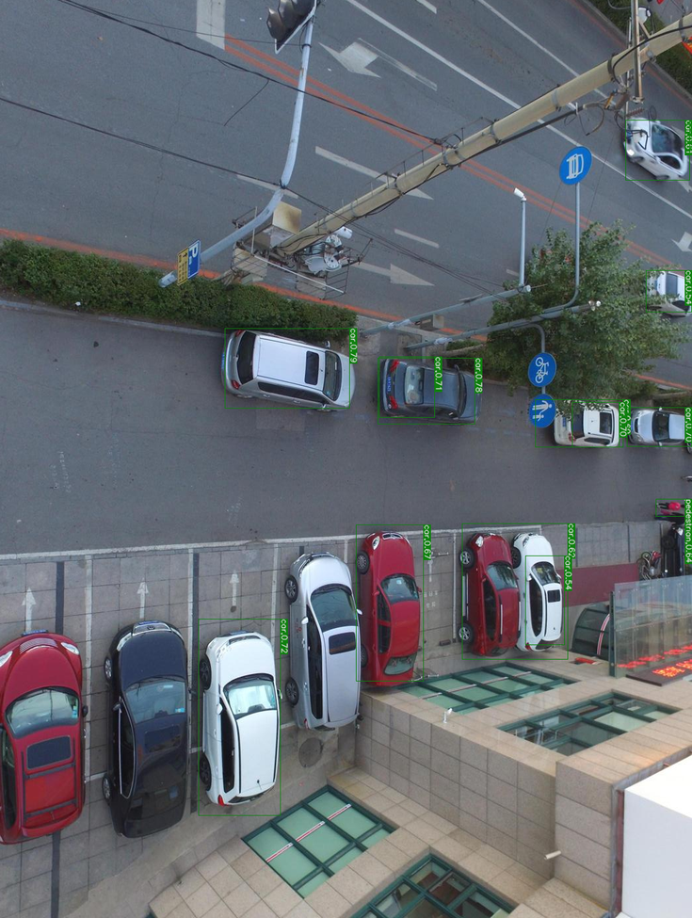
Have researched about existing model and architecture for small object detection like, EfficientDet, QueryDet, SyNet(Faster RCNN), HoughNet, YoloV5 and End to End Detection.
Tried to implement all of them using the resources available.
We have chosen VisDrone Dataset to perform the tasks using all the different type of detectors.
To do so, converted the dataset of VisDrone to COCO format.(Most famous and originally used dataset for training of most of the detectors.
We have implemented the models and evaluated the performances with different methods like, AP, Average Recall,IoU and precession .
our Approach

Slide 13
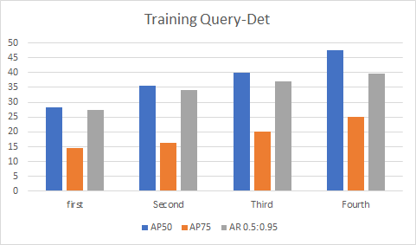
Analysis

Slide 14
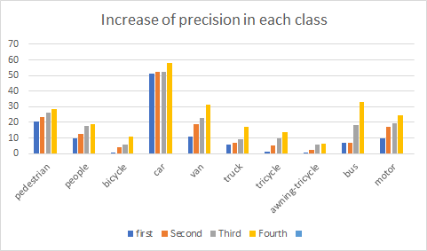

Slide 15
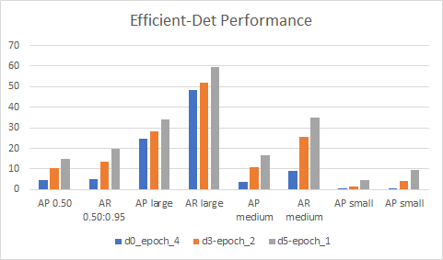

Slide 16
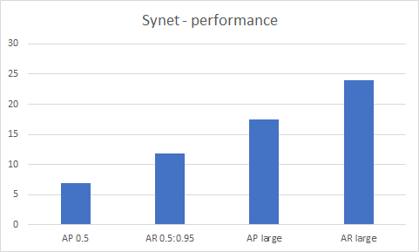

Slide 17
Results
 | AP 0.5 | AR 0.5:0.95 | AP small | AP medium | AP large
QueryDet | 47.48 | 39.55 | - | - | -
EfficientDet-d0 | 4.7 | 5.8 | 0.1 | 3.6 | 24.8
EfficientDet-d3 | 10.3 | 13.7 | 1.7 | 11.0 | 28.3
EfficientDet-d5 | 14.9 | 19.9 | 4.5 | 16.5 | 34.2
Faster RCNN | 6.9 | 11.8 | 3.1 | 6.3 | 17.5

Slide 18
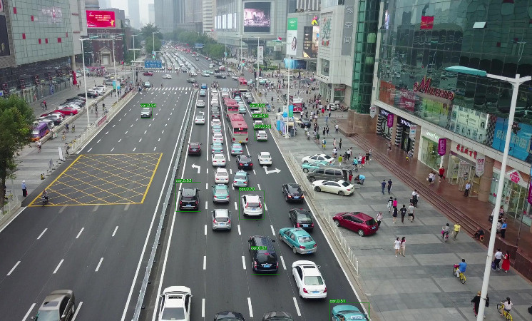
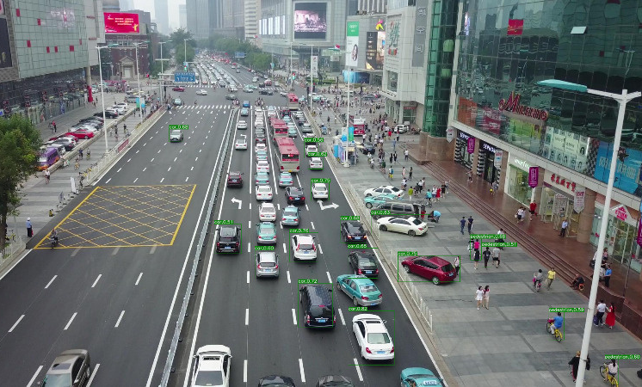
Change of object detection by more training

Slide 19
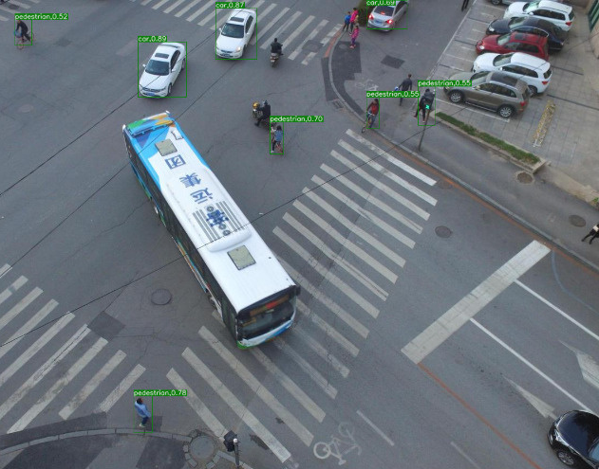
Less object detection problem

Slide 20

Role of each group member in the project
Jay Patel
Understanding the Coding Structure of Deep Learning
Coding implementation of EfficientDet, QueryDet
Literature Survey
Dhanya Mehta
Coding implementation of End To End Detection Transformer, YOLO V5
Understanding of Model architecture
Literature Survey
Spandan Shah
Literature Survey
Understanding of Model architecture
Coding implementation of SyNet, HoughNet

Slide 21
References
[1]
[2]
[3]
[4]
[5]
[6]
EfficientDet - Tan, M., Pang, R., & Le, Q. V. (2020, July 27). EfficientDet: Scalable and efficient object detection. arXiv.org. Retrieved February 25, 2023, from https://doi.org/10.48550/arXiv.1911.09070
QueryDet - Yang, C., Huang, Z., & Wang, N. (2022, March 24). Querydet: Cascaded sparse query for accelerating high-resolution small object detection. arXiv.org. Retrieved March 1, 2023, from https://arxiv.org/abs/2103.09136
SyNet - Albaba, B. M., & Ozer, S. (2020, December 23). SyNet: An ensemble network for object detection in UAV images. arXiv.org. Retrieved March 24, 2023, from https://doi.org/10.48550/arXiv.2012.12991
HoughNet - Samet, N., Hicsonmez, S., & Akbas, E. (2020, July 24). Houghnet: Integrating near and long-range evidence for bottom-up object detection. arXiv.org. Retrieved April 2, 2023, from https://doi.org/10.48550/arXiv.2007.02355
End to End Detection - Carion, N., Massa, F., Synnaeve, G., Usunier, N., Kirillov, A., & Zagoruyko, S. (2020, May 28). End-to-end object detection with Transformers. arXiv.org. Retrieved March 27, 2023, from https://doi.org/10.48550/arXiv.2005.12872
YoloV5 - jocher, glenn. (n.d.). Ultralytics/yolov5: Yolov5 🚀 in PyTorch > ONNX > CoreML > TFLite. GitHub. Retrieved April 10, 2023, from https://github.com/ultralytics/yolov5

